Slide 1
Profesor Kovačić na Geotehničkom fakultetu u Varaždinu
HRVATSKA KOMORA INŽENJERA GRAĐEVINARSTVA
Dani Hrvatske komore inženjera građevinarstva Opatija, 2019.
Igor Petrović
Izv.prof.dr.sc. Igor Petrović, dipl.ing.geot., Geotehnički fakultet, Varaždin
Notes:
1

Slide 2
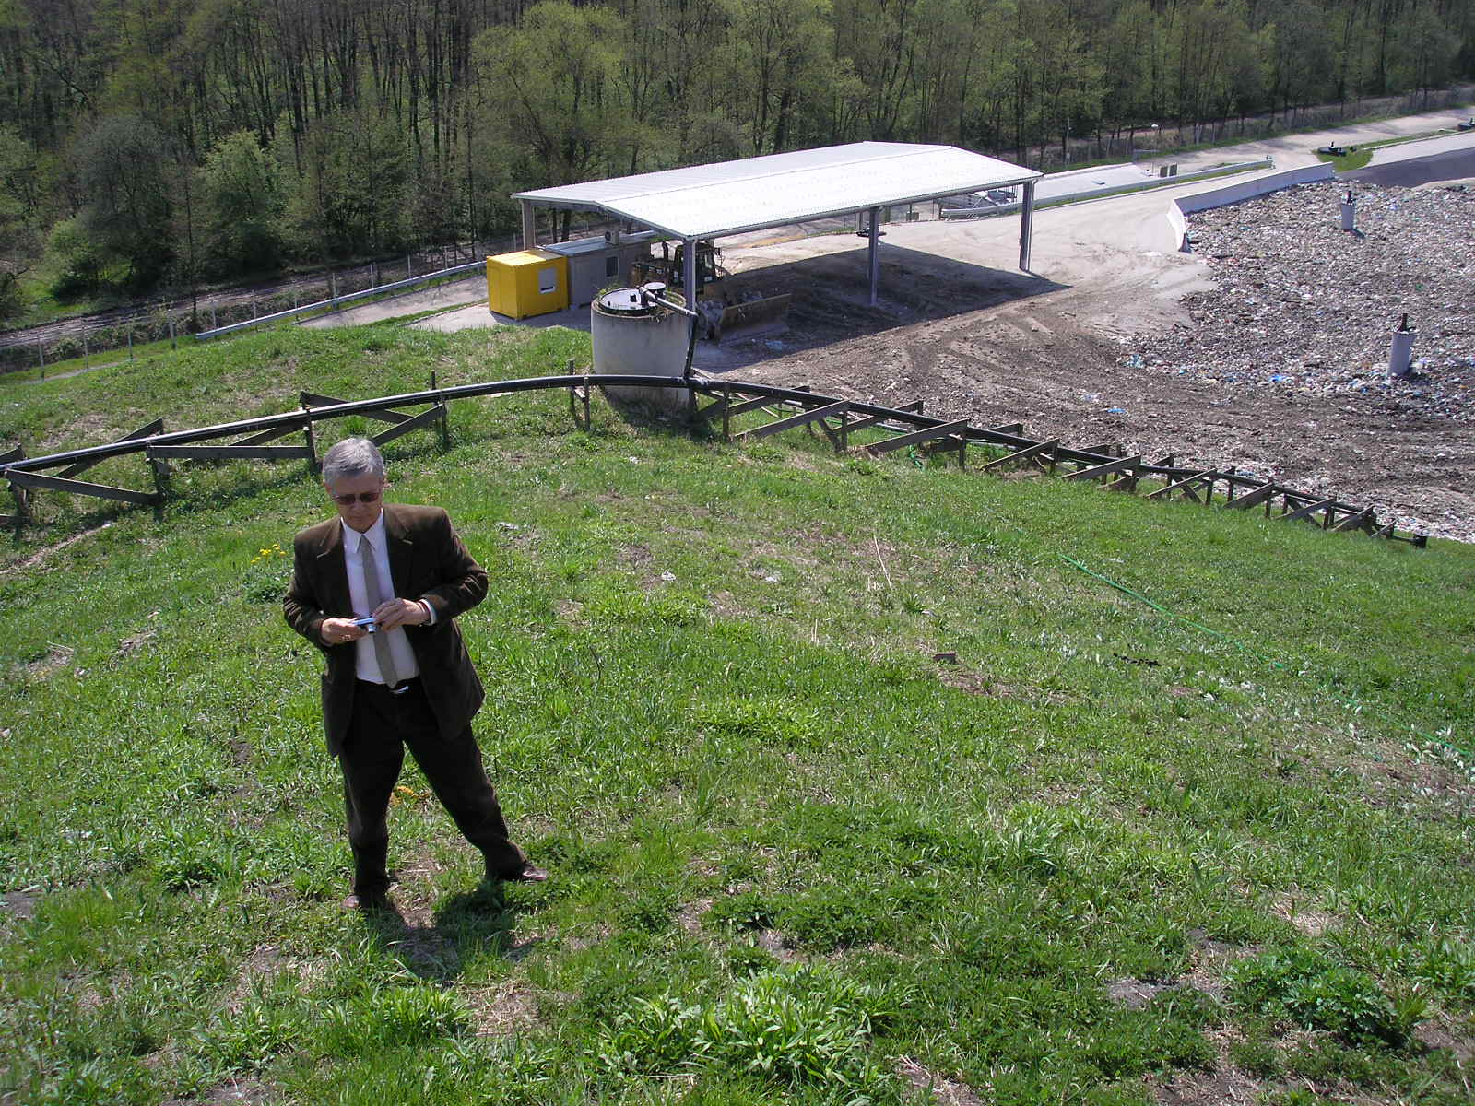

Slide 3
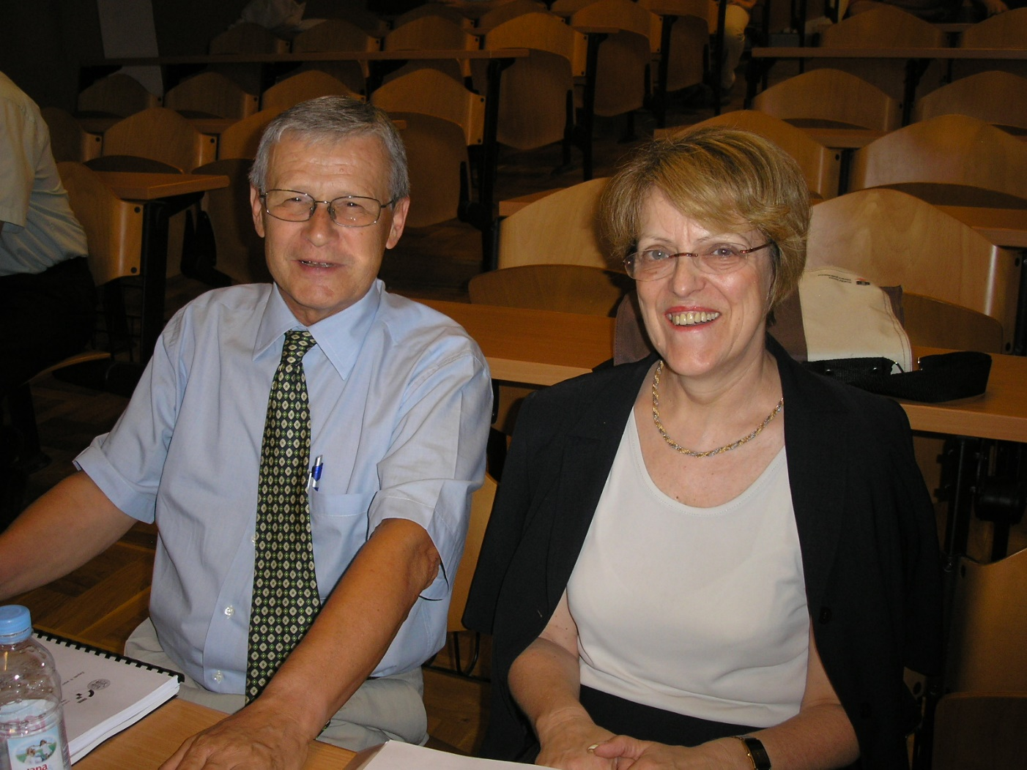
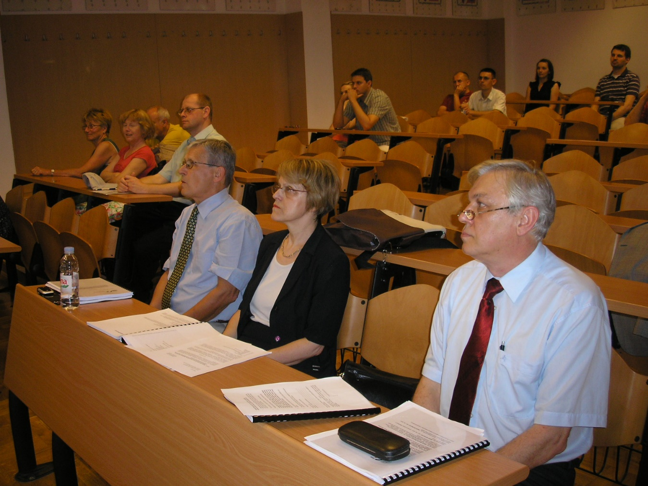

Slide 6
SCOPUS
Kovacic, Davorin; Petrovic, Igor; Stuhec, Damir; Kovacević Zelic, Biljana; Veinovic, Zelimir; Znidarcic, Dobroslav. Impervious Barriers for Landfills in Karst Region of Istrian Peninsula // Rock Engineering in Difficult Ground Conditions - Soft Rocks and Karst / Vrkljan, I. (ed.). Taylor & Francis Group, London, 2009. 711-716
Web of Science Core Collection
Petrovic, Igor; Ivsic, Tomislav; Veric, Franjo; Kovacic, Davorin. Sensitivity analyses of global stability in sanitary landfills // Sixth European Conference on Numerical Methods in Geotechnical Engineering, September 2006, Graz, Austria
SCI-EXPANDED
Petrovic, Igor; Szavits-Nossan, Vlasta; Kovacic, Davorin. Deformability of municipal waste after biomechanical treatment // Gradevinar 63 (2011), 3; 255-264
CURRENT CONTENTS
Petrovic, Igor; Kovacic, Davorin; Damir Štuhec. Large Oedometer for Measuring Stiffness of MBT Waste. // Geotechnical Testing Journal, ASTM, 37 (2014); 296-310

Slide 7
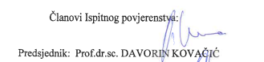

Slide 8
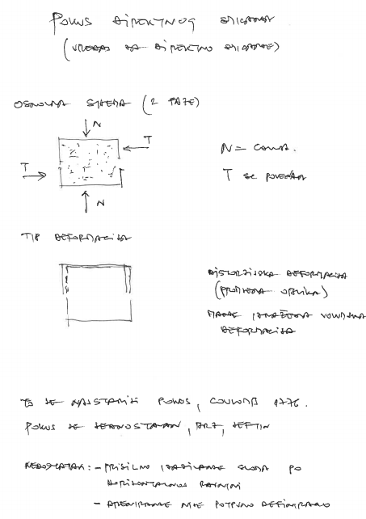

Slide 13
