Slide 1

Performance-based approach for complex structure design
HRVATSKA KOMORA INŽENJERA GRAĐEVINARSTVA
Dani Hrvatske komore inženjera građevinarstva Opatija, 2019.
Ing. Samuele Sassi
Samuele Sassi, FSC Engineering Srl, Fire Engineering and Fire Safety
Design Consultants, Milan
Notes:
1

Slide 2
Identification of
performance levels
performance levels
(I, II, III, IV, V)
Choice of
type of solution
Compliant solution
Alternative solution
(FSE)
Fire resistance
- Prescriptive standard
- fire load (EN 1991-2)
verification according to natural fire curves
verification according to Standard fire curves

Slide 3
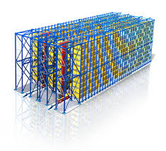
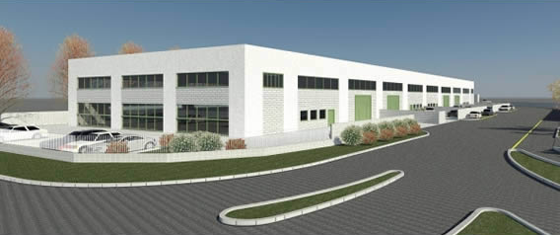
PERFORMANCE LEVELS

Slide 4
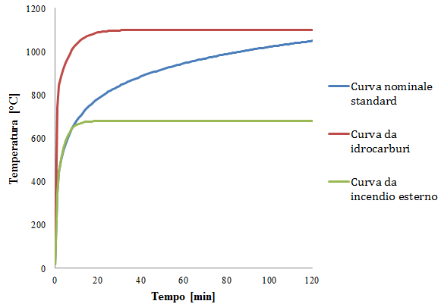
Italian law and regulamentations
STRUCTURAL FIRE RESISTACE ANALYSIS
Prescriptive approach
(standard or fire load )
Performance based approach
Ref.
EN 1991-1-2
Natural Curves
Nominal Curves
Test based curves
Parametric curves
Nominal standard (ISO 834)
Simplified models
Local fire model
Hydrocarbons fire
Advanced models
Single zone model
External fire
Two zone model
CFD models
Notes:
45’’

Slide 5
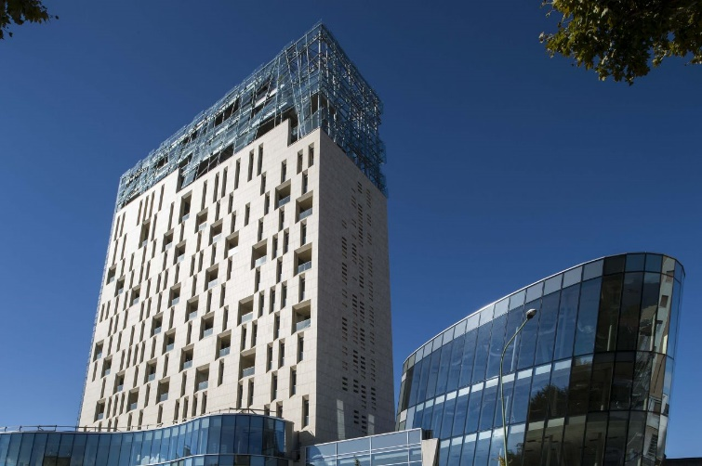
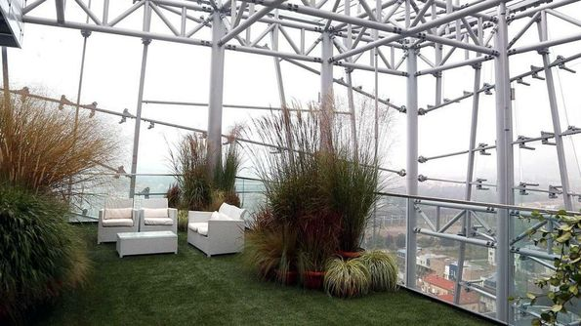
BRESCIA SKYLINE 18

Slide 13
Local fire
Local fire + natural fire curves

Slide 14
E_{fi,d} < R_{fi,d,t}

Slide 15
ANALISI PER SINGOLI ELEMENTI
O PER SOTTOSTRUTTURE
m_{t=o}
m_{t=o}
F_{o1(t=o)}
F_{v1(t=o)}
F_{v2(t=o)}
F_{o2(t=o)}
m_{t=o}
m_{t=o}
F’_{o1(t=o)}
F’_{o2(t=o)}
m_{t=o}
F’_{v2(t=o)}
m_{t=o}
F’_{v1(t=o)}

Slide 16
SFSE (Structural Fire Safety Engineering)
Define the targets
(reduce costs of maintenance, beauty of the building, ensure the stability of
the building, etc.);
Focalize the main activities inside the building;
Understand the global behaviour of the structure
(it is important define the structural hierarchy of the elements - robustness);
Define the WORST FIRE SCENARIO
(position, fire curve, etc.)
Check the behaviour of the structure under fire conditions

Slide 17
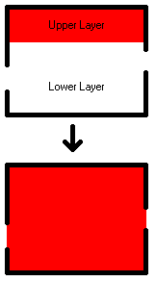
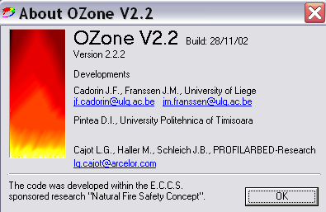
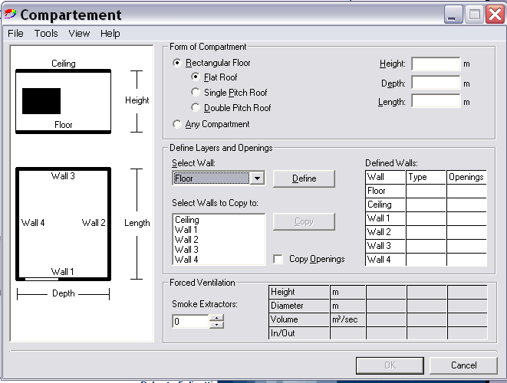
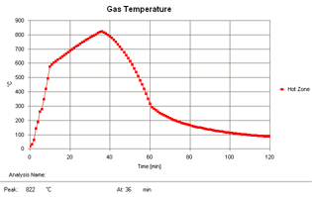
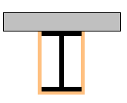
ZONE MODEL
2 zone
1 zone
T_{up} > 500°C
h_{up} > 80% h
flashover
Natural Fire curve

Slide 18
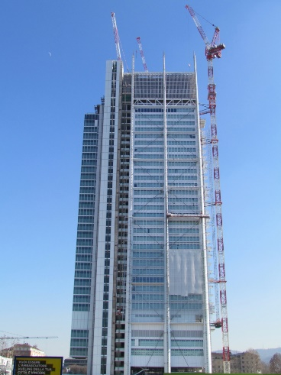
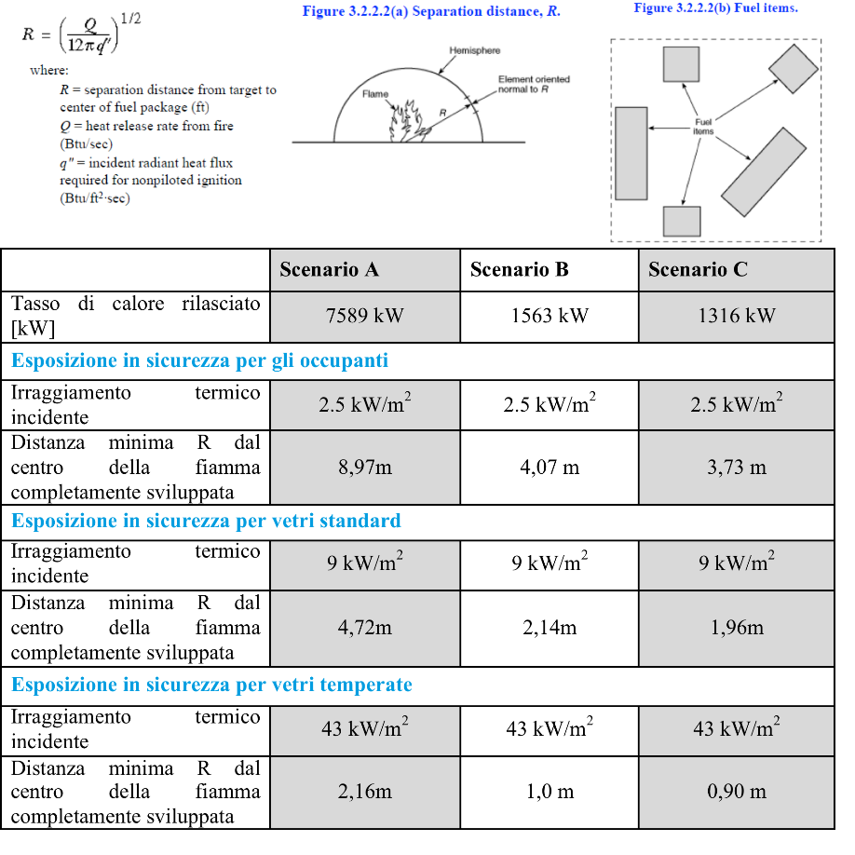
Torre Intesa San Paolo (Torino) - Greenhouse

Slide 19
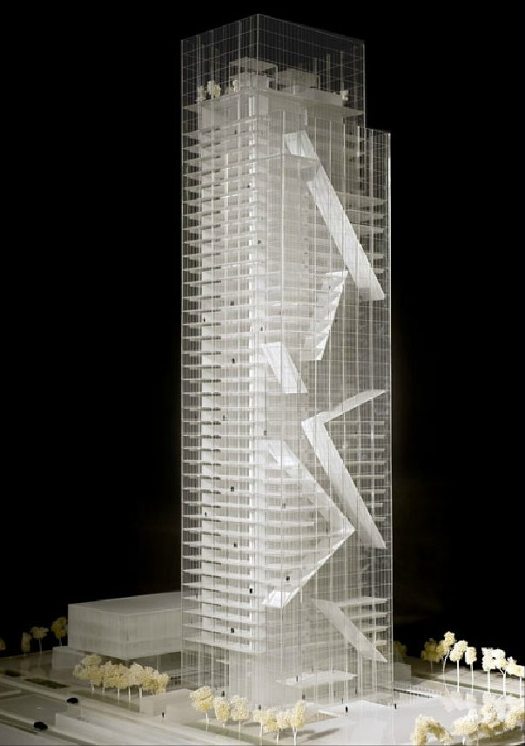
Cases studies: Piedmont Region Headquarters - Turin

Slide 20
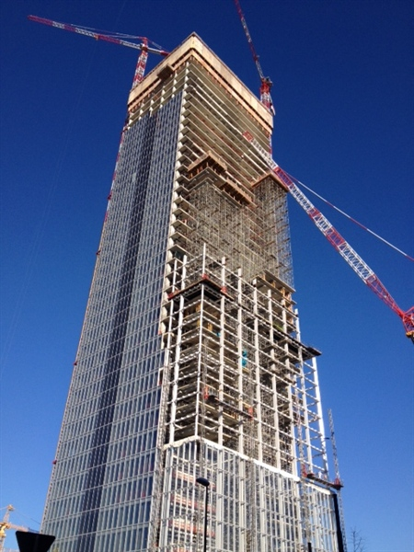
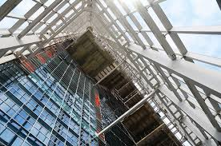
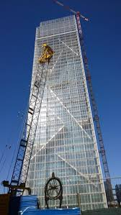
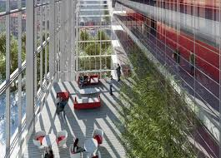
Cases studies: Piedmont Region Headquarters - Turin

Slide 21
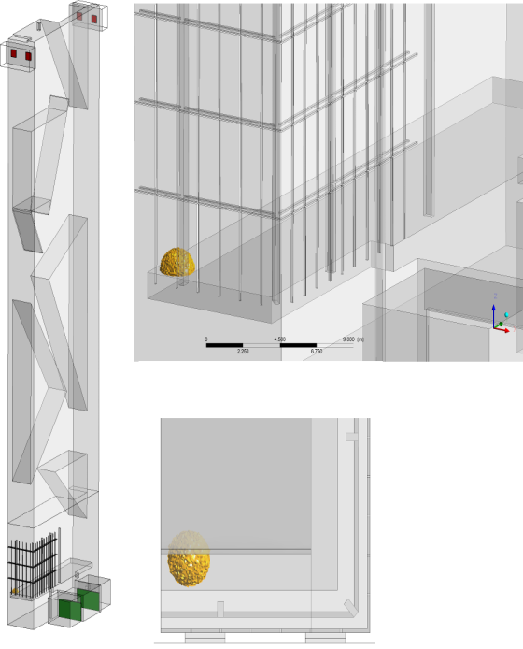
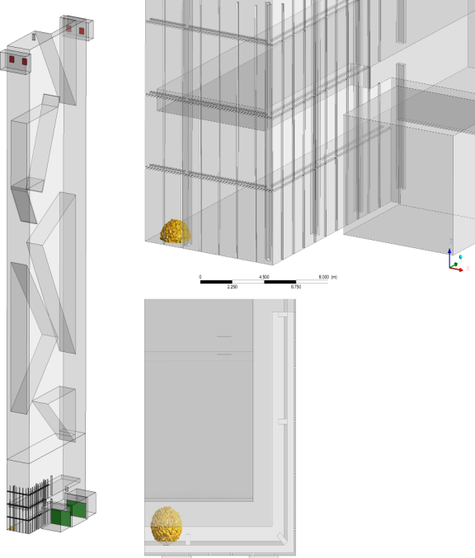
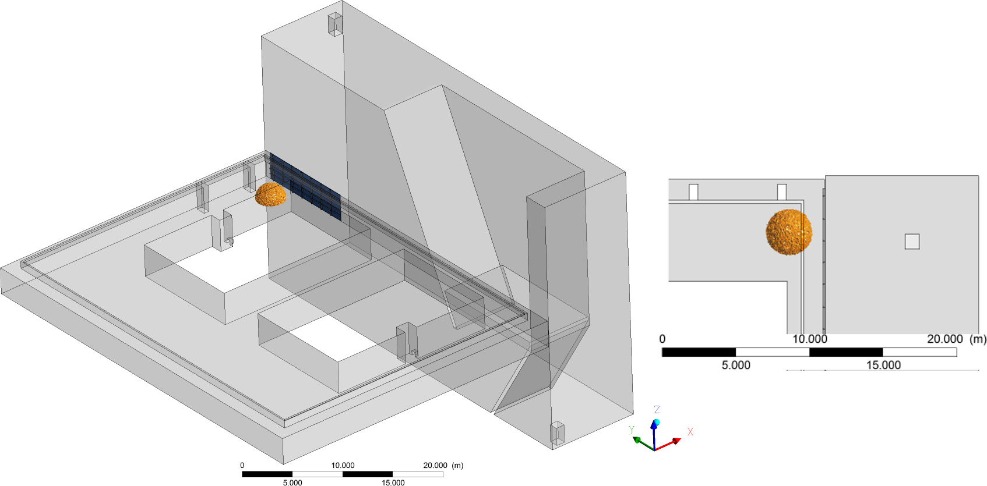
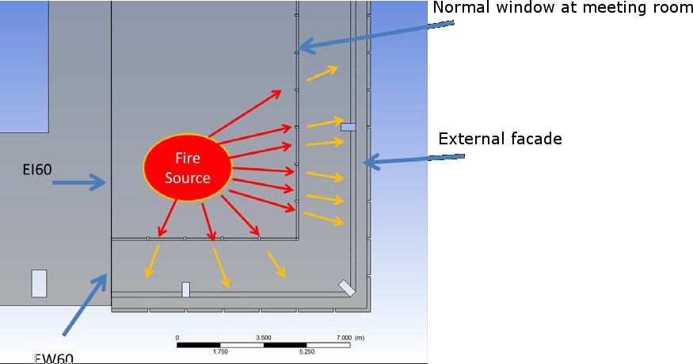
Cases studies: Piedmont Region Headquarters - Turin
Design Fire Scenarios
• Fire:
1 – Fire at leve 0 Grand Space
2 – Fire at level -2 Grand Space
3&4 – Fire iside the office level
5&6 – Fire inside the Satellite

Slide 22

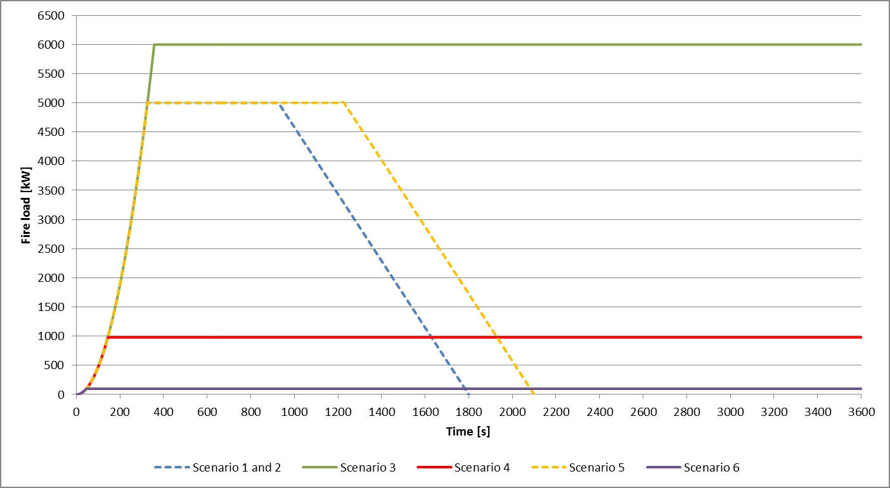
Cases studies: Piedmont Region Headquarters - Turin
Fire Scenario 1 – Fire inside the Grand Space at level 0

Slide 23
BOUNDARIES scenario 1
Cases studies: Piedmont Region Headquarters - Turin
• Fire
• The fire development coefficient is 0.047 kW/s2.
• The are no sprinklers and the fire reached maximum effect of 5 MW after 326 s. The fire load is assumed to be constant of 10 minutes after its reached maximum. After this it decreases linearly.
• Ventilation
• Smoke beam detectors are activated after 30 s and opens the openings in the bottom at level -2 for fresh air and the openings in the top.

Slide 24
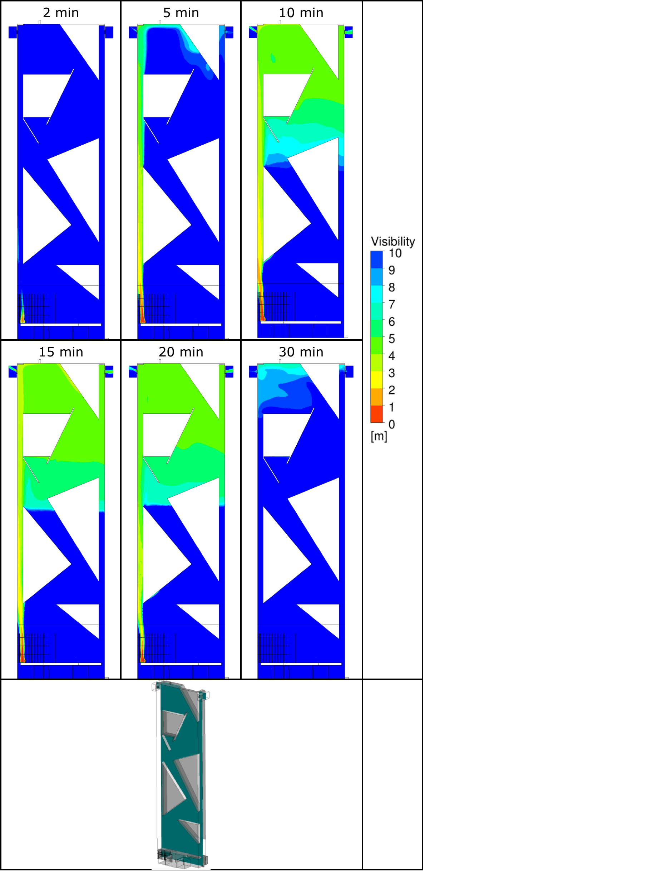
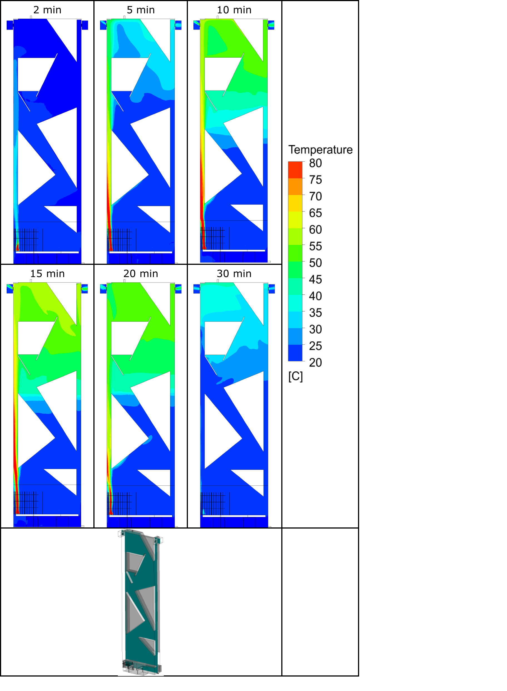
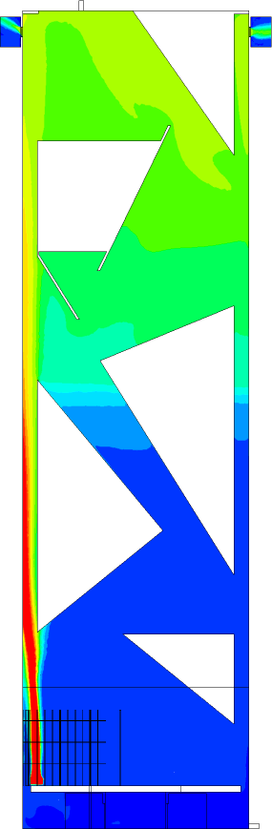
Cases studies: Piedmont Region Headquarters - Turin
Fire Scenario 1 – Fire inside the Grand Space at level 0

Slide 25
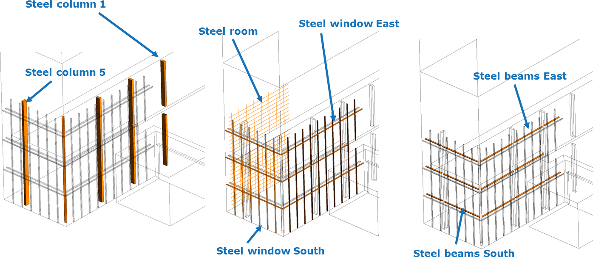
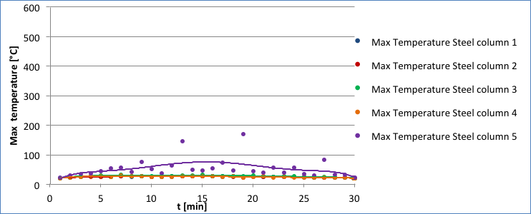
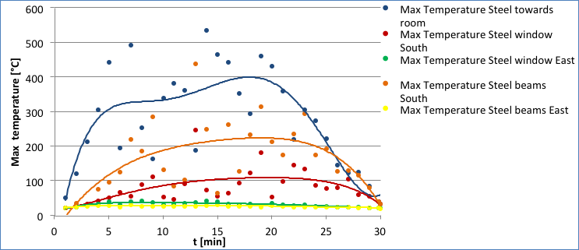
Cases studies: Piedmont Region Headquarters - Turin
Fire Scenario 1 – Fire inside the Grand Space at level 0

Slide 26

Cases studies: Piedmont Region Headquarters - Turin
Fire Scenario 2 – Fire inside the Grand Space at level -2

Slide 27
BOUNDARIES scenario 2
Cases studies: Piedmont Region Headquarters - Turin
• Fire
• The fire development coefficient is 0.047 kW/s2.
• The are no sprinklers and the fire reached maximum effect of 5 MW after 326 s. The fire load is assumed to be constant of 10 minutes after its reached maximum. After this it decreases linearly.
• Ventilation
• Smoke beam detectors are activated after 30 s and opens the openings in the bottom at level -2 for fresh air and the openings in the top.

Slide 28
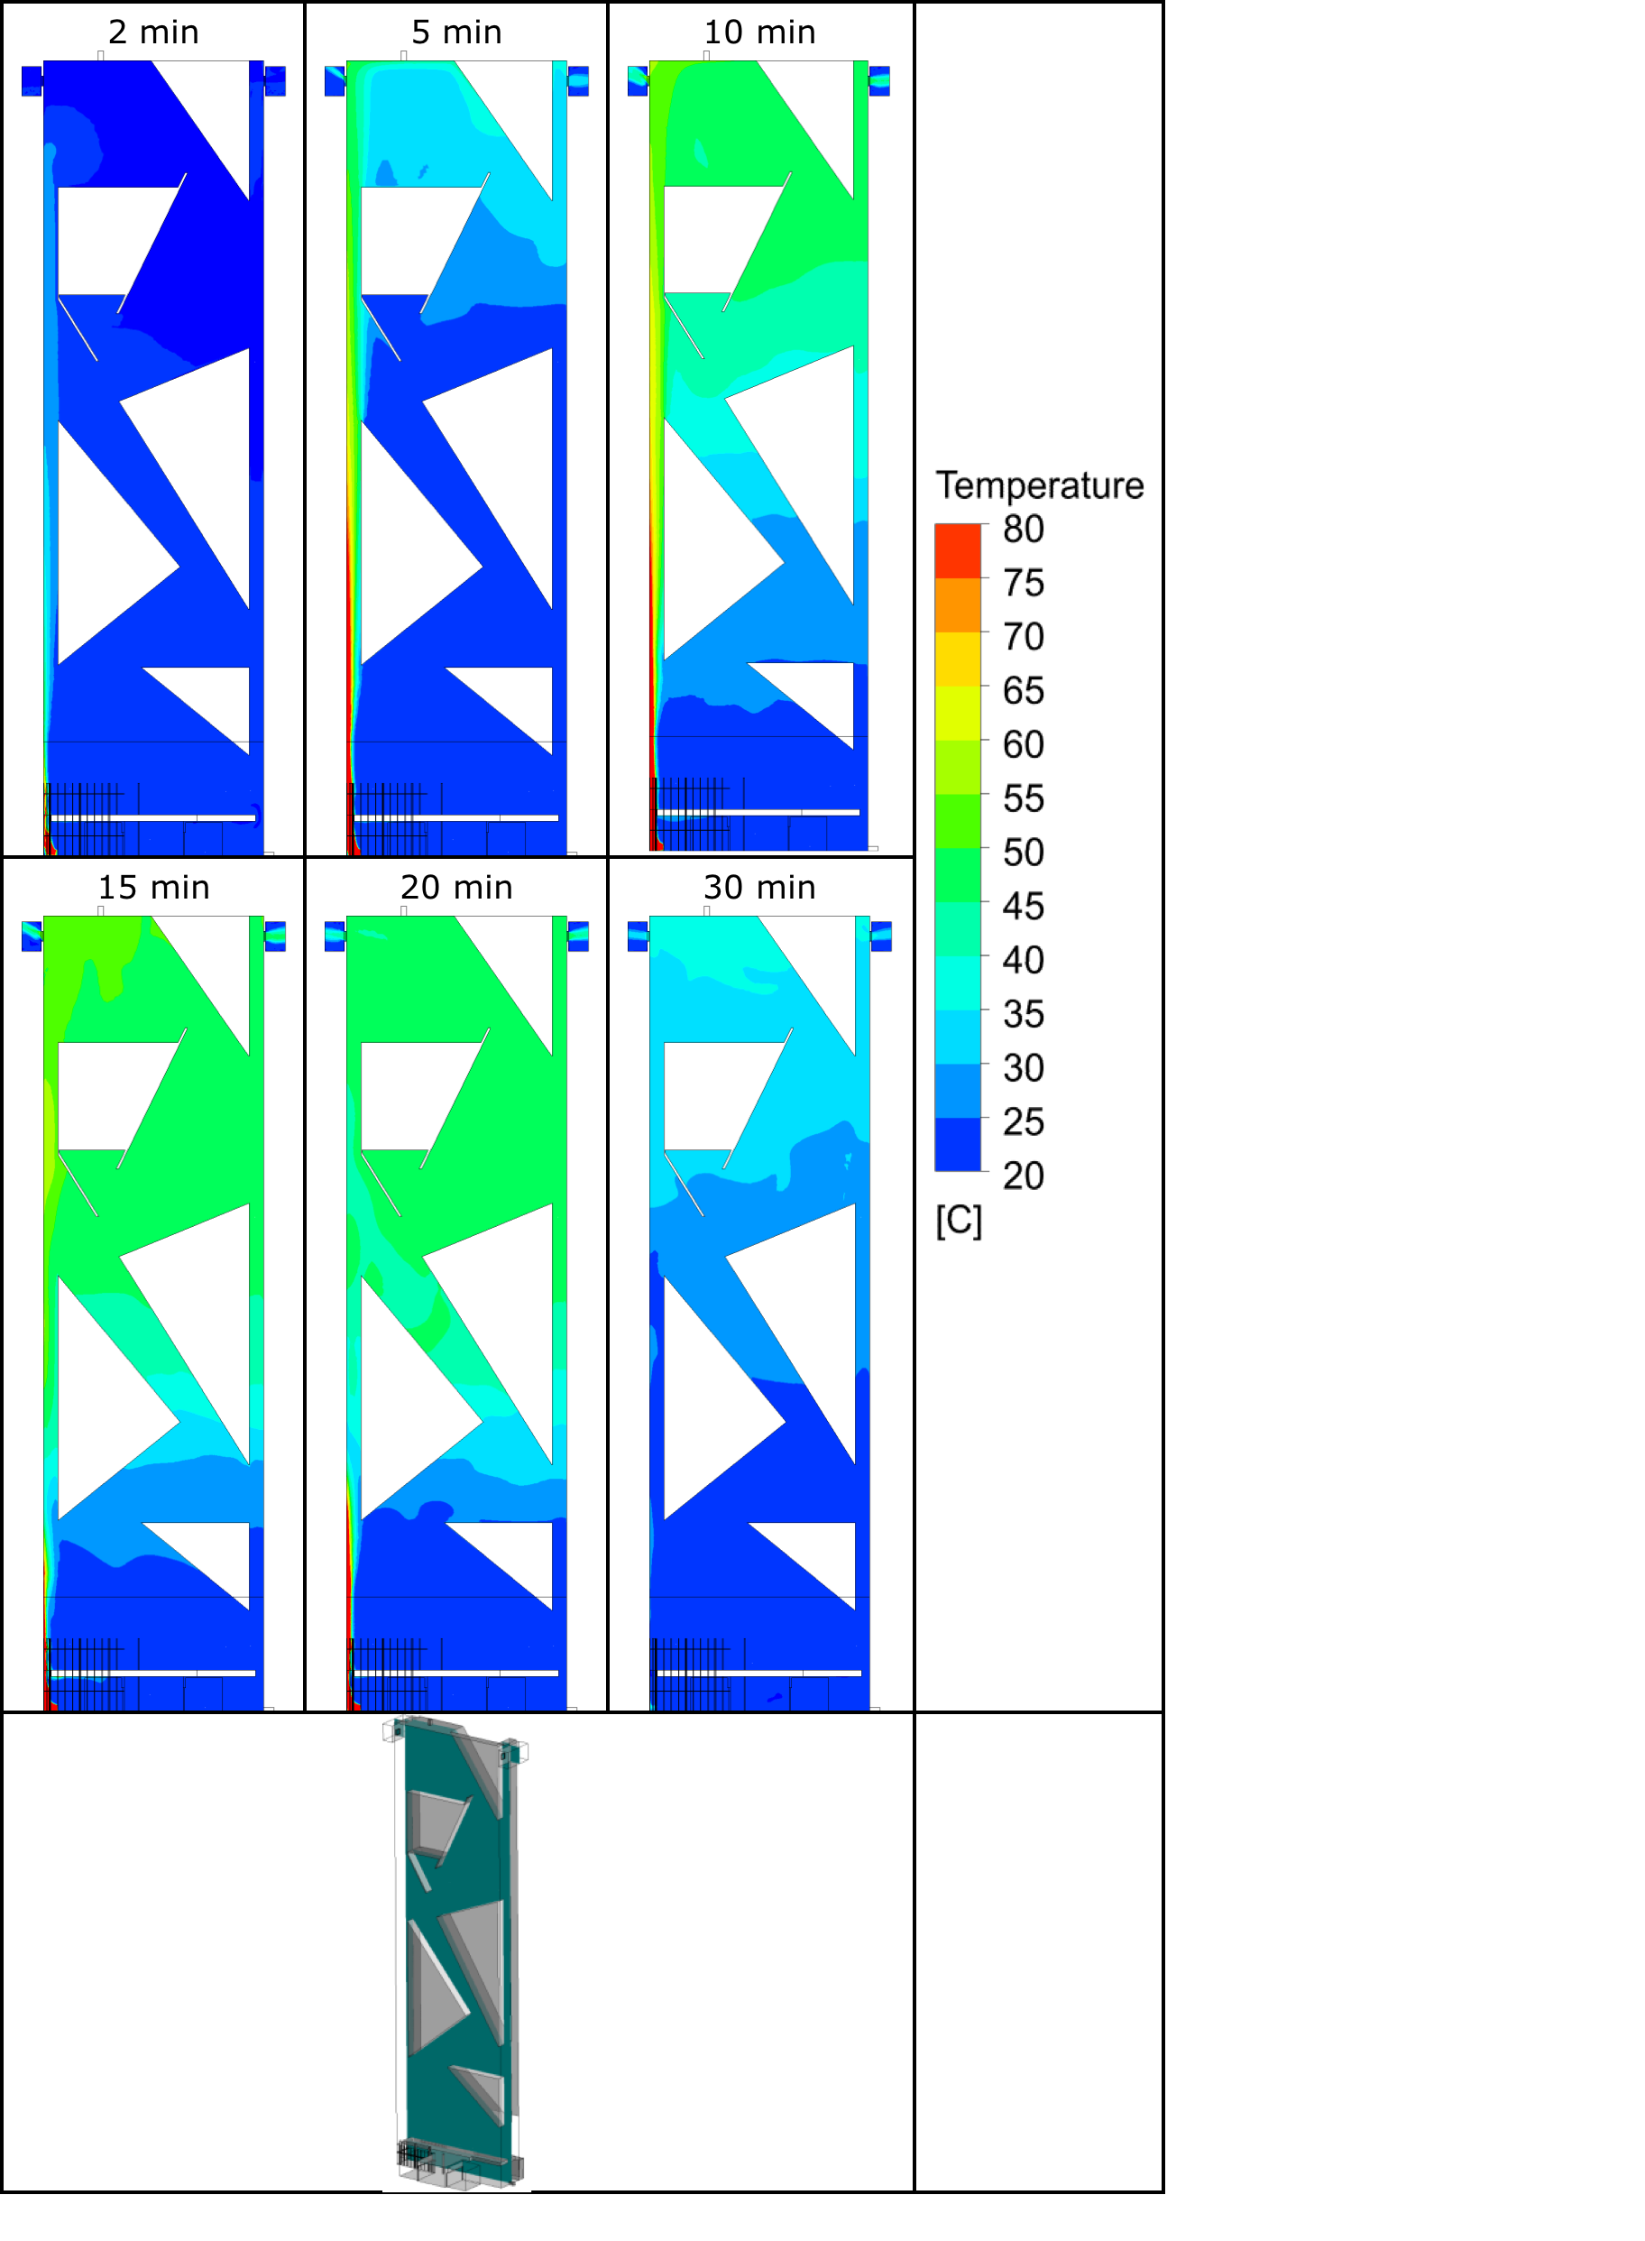
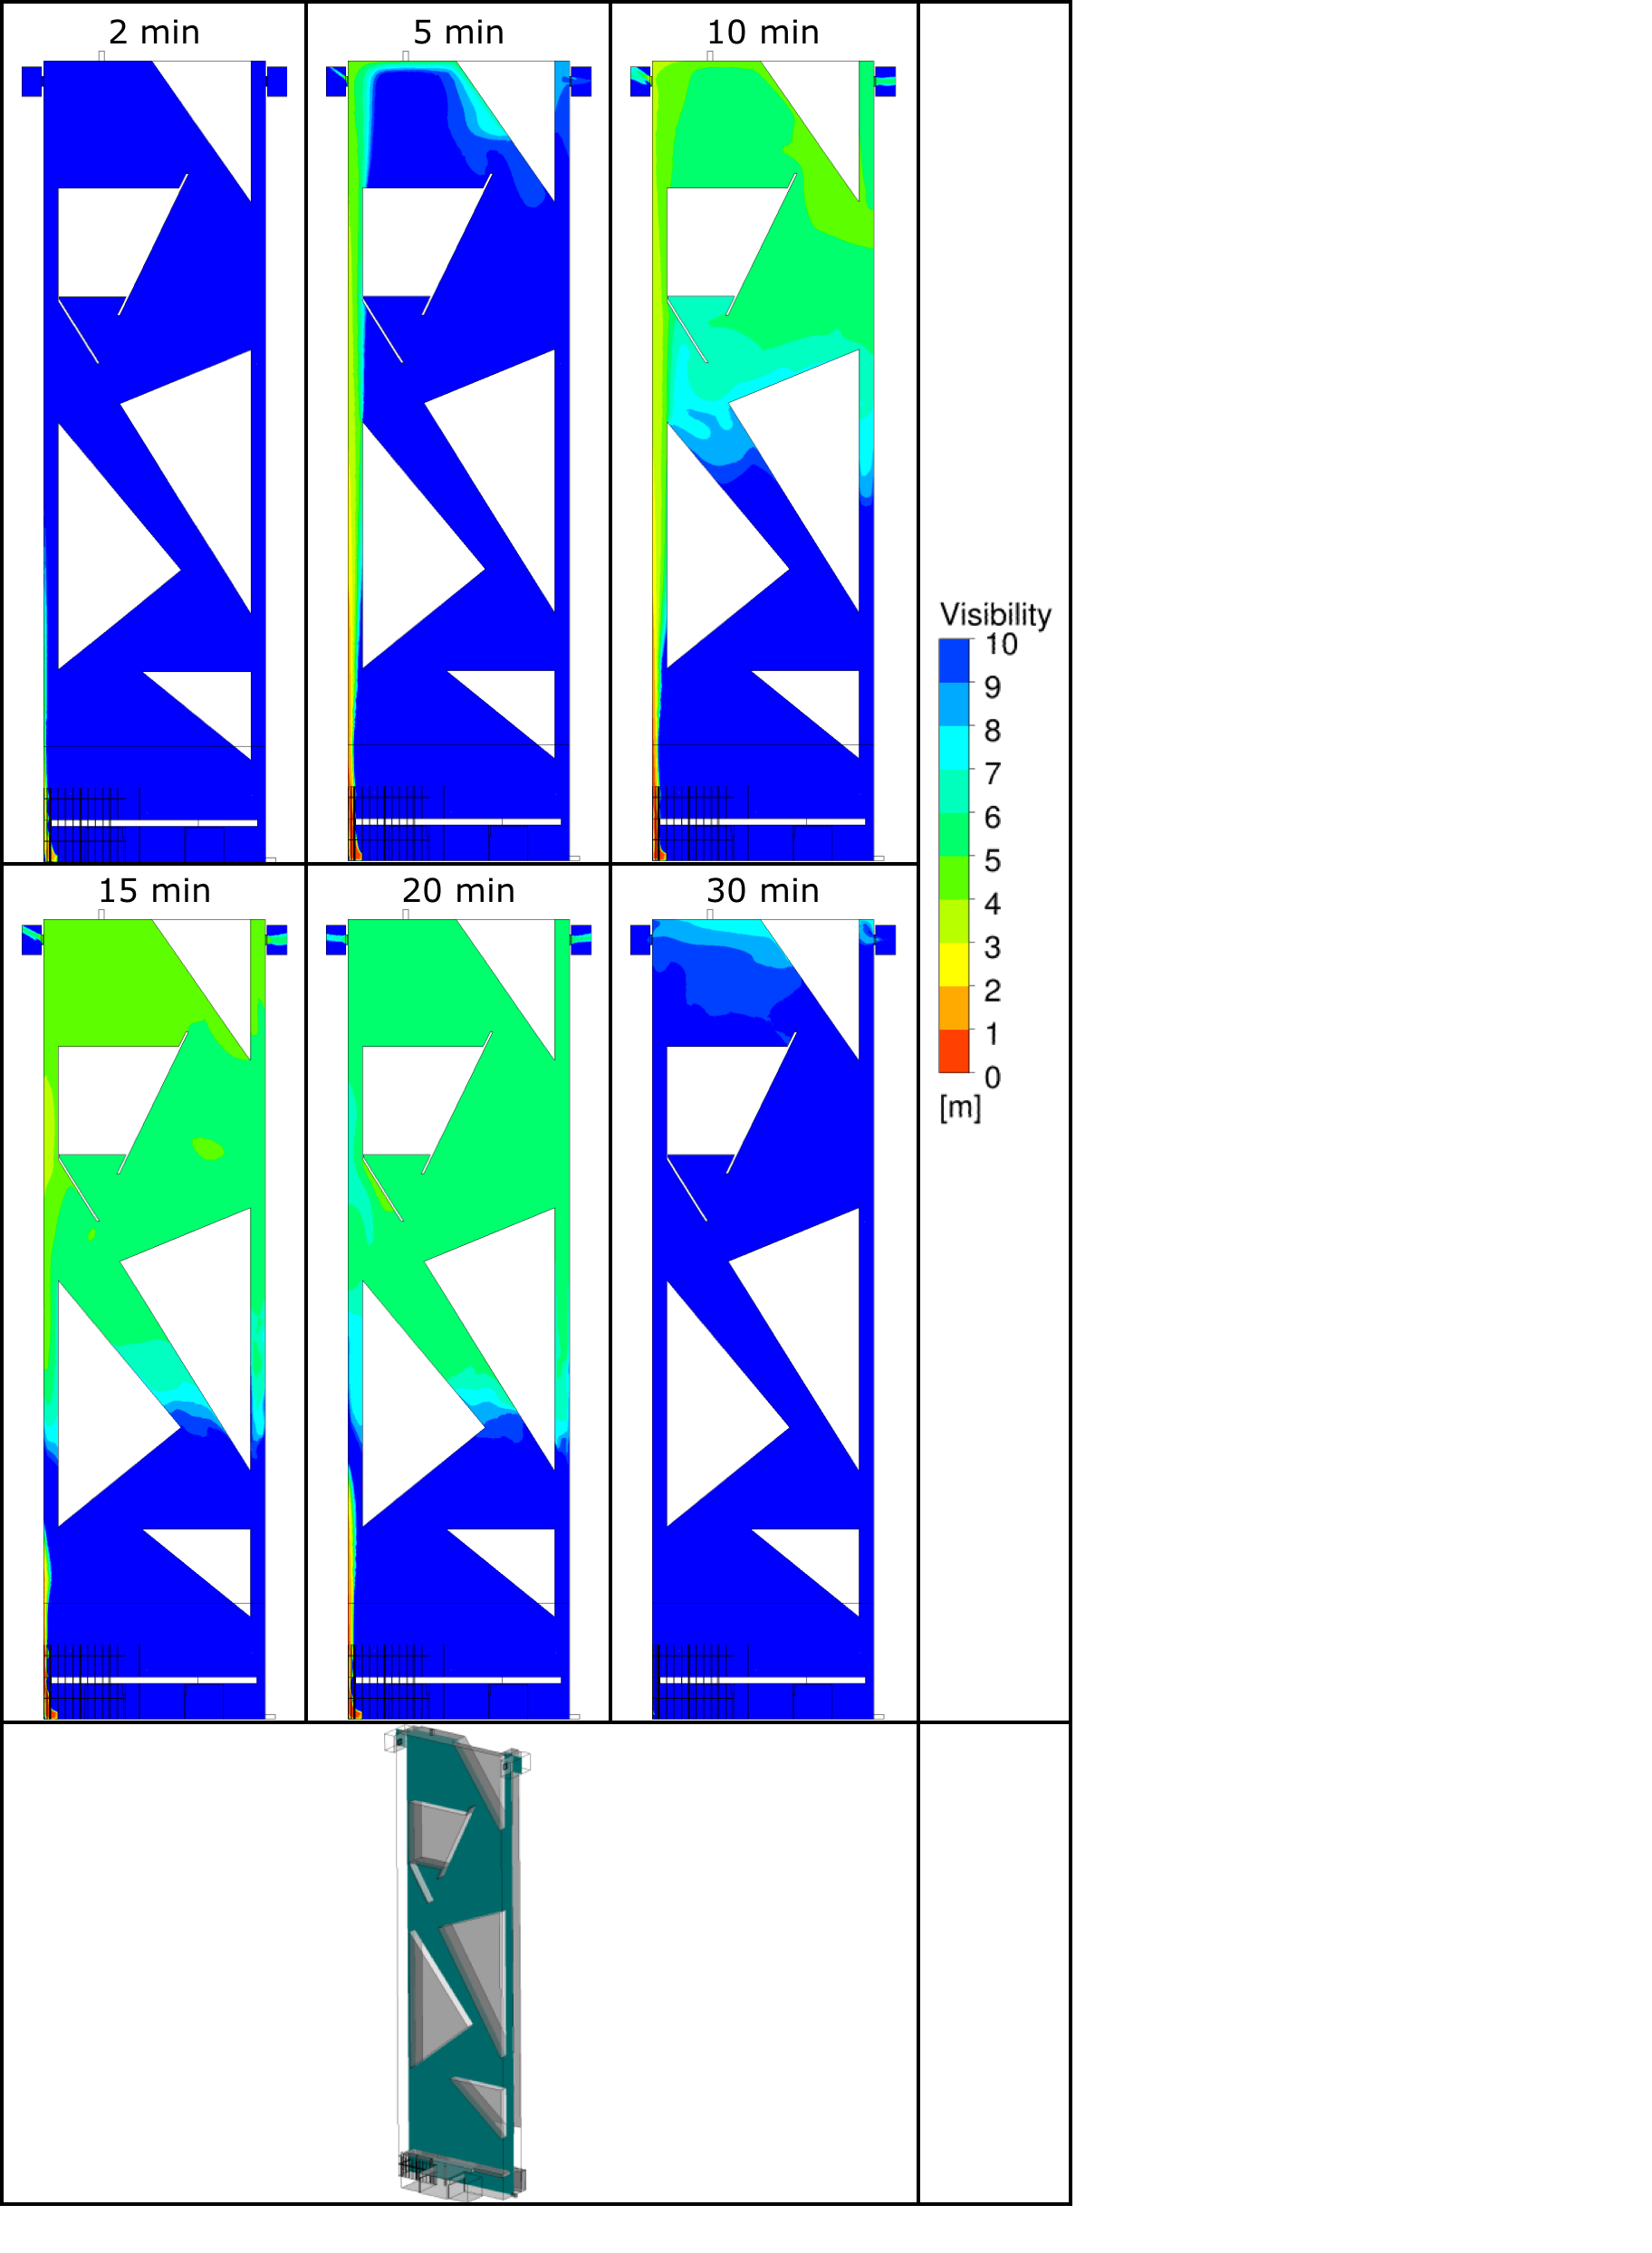
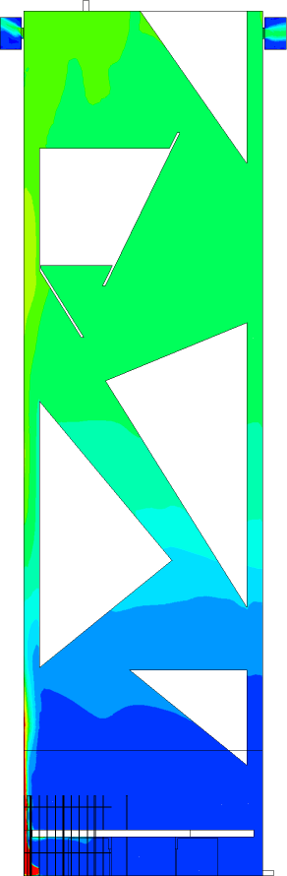
Cases studies: Piedmont Region Headquarters - Turin
Fire Scenario 2 – Fire inside the Grand Space at level -2

Slide 29
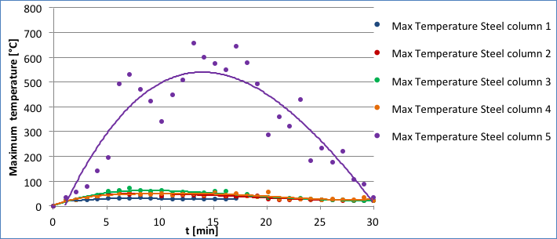
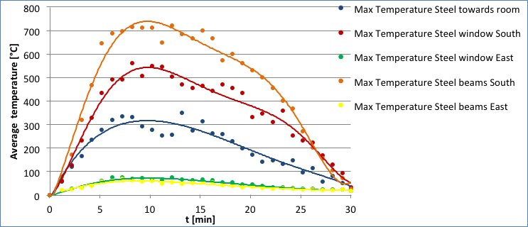
Cases studies: Piedmont Region Headquarters - Turin
Fire Scenario 2 – Fire inside the Grand Space at level -2

Slide 30
Cases studies: Piedmont Region Headquarters - Turin
Fire Scenario 3 & 4 – Fire inside the office

Slide 31
BOUNDARIES
Scenario 3 – Fire inside the office no sprinkler
Cases studies: Piedmont Region Headquarters - Turin
Fire
The fire development coefficient is 0.047 kW/s2.
Fire develops to up to an HRR value of 6 MW. It reaches its maximum effect after 326 s and remains constant for 1 hour. .
Ventilation
Smoke detectors are activated after 40 s and gives start signal for the ventilation. The ventilation has full capacity after 100 s. A ramp up time of 60 s is assumed.
The extracted air in the office is 12.000 m3/h
Air is supplied by two openings. Each opening has a area of 0.5 m x 0.5 m

Slide 32
BOUNDARIES
Scenario 4– Fire inside the office with sprinkler
Cases studies: Piedmont Region Headquarters - Turin
• Fire
• The fire development coefficient is 0.047 kW/s2.
• The sprinklers are activated after 145 s and the fire load is thereby reduced to 0.98 MW.
• Ventilation
• Smoke detectors are activated after 40 s and gives start signal for the ventilation. The ventilation has full capacity after 100 s. A ramp up time of 60 s is assumed.
• The extracted air in the office is 12.000 m3/h
• Air is supplied by two openings. Each opening has a area of 0.5 m x 0.5 m

Slide 33
Cases studies: Piedmont Region Headquarters - Turin
Fire Scenario 3 & 4 – Fire inside the office

Slide 34
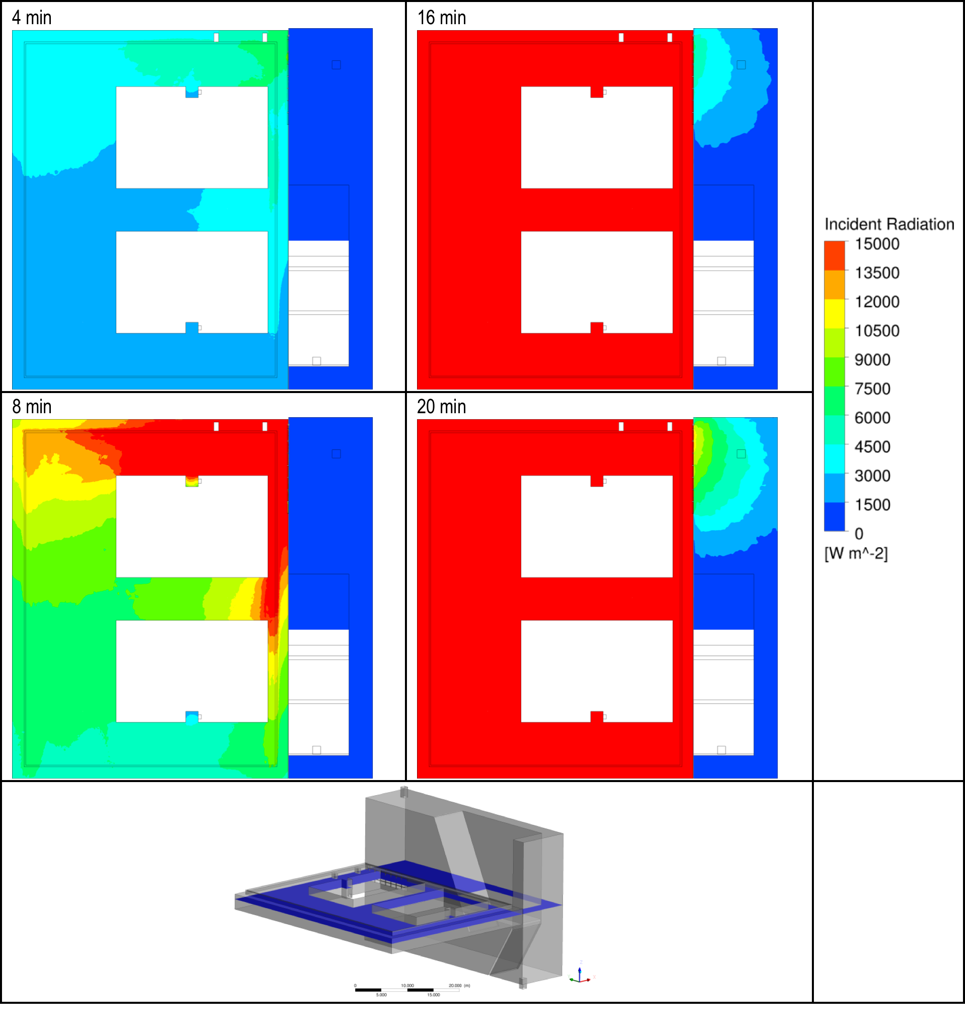
Cases studies: Piedmont Region Headquarters - Turin
Fire Scenario 3 & 4 – Fire inside the office

Slide 35
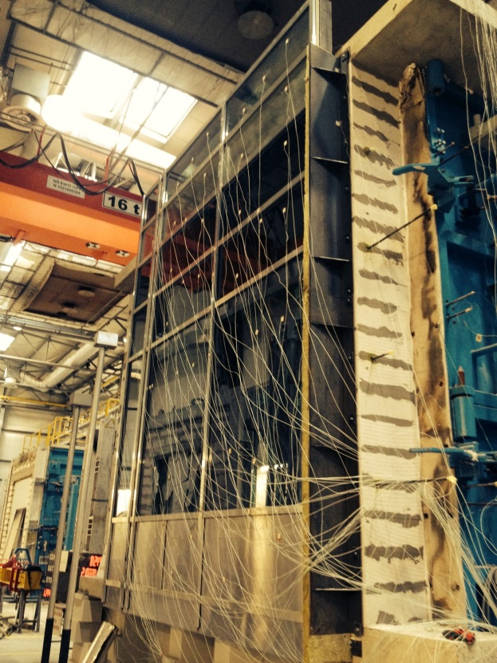
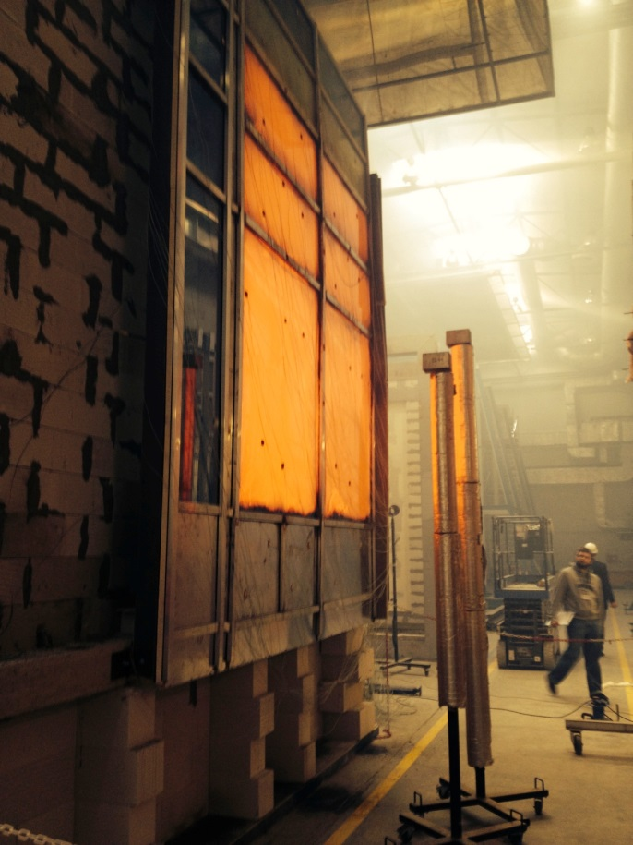
Cases studies: Piedmont Region Headquarters - Turin
Fire Scenario 3 & 4 – TEST FOR FAÇADE EW 60 (i->o)

Slide 36
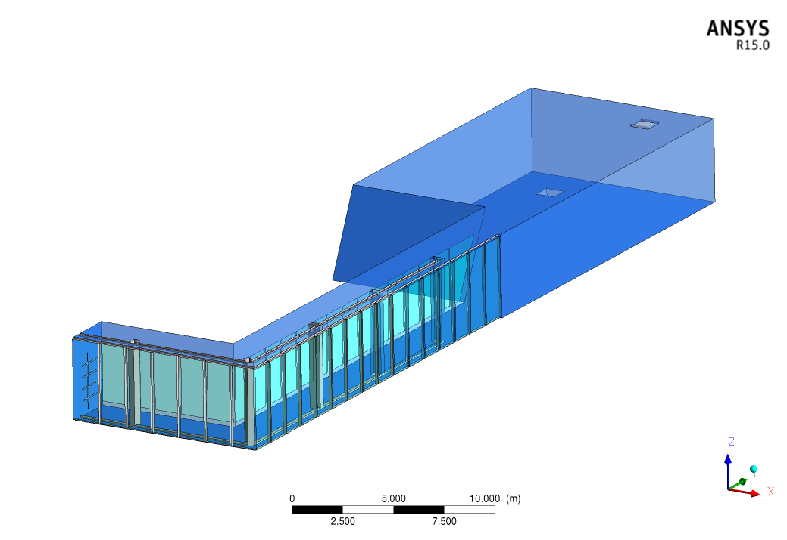
Cases studies: Piedmont Region Headquarters - Turin
Fire Scenario 5 & 6 – Fire inside the Satellite

Slide 37
BOUNDARIES
Scenario 5 – Fire inside the satellite no water-mist
Cases studies: Piedmont Region Headquarters - Turin
• Fire
• The fire development coefficient is 0.047 kW/s2.
•HRR load reaches 5 MW and remains constant for 15 minutes

Slide 38
BOUNDARIES
Scenario 6 – Fire inside the satellite with water-mist
Cases studies: Piedmont Region Headquarters - Turin
• Fire
• The fire development coefficient is 0.047 kW/s2.
•The water mist are activated after 46 s and the fire load is thereby reduced to 0.1 MW.

Slide 39
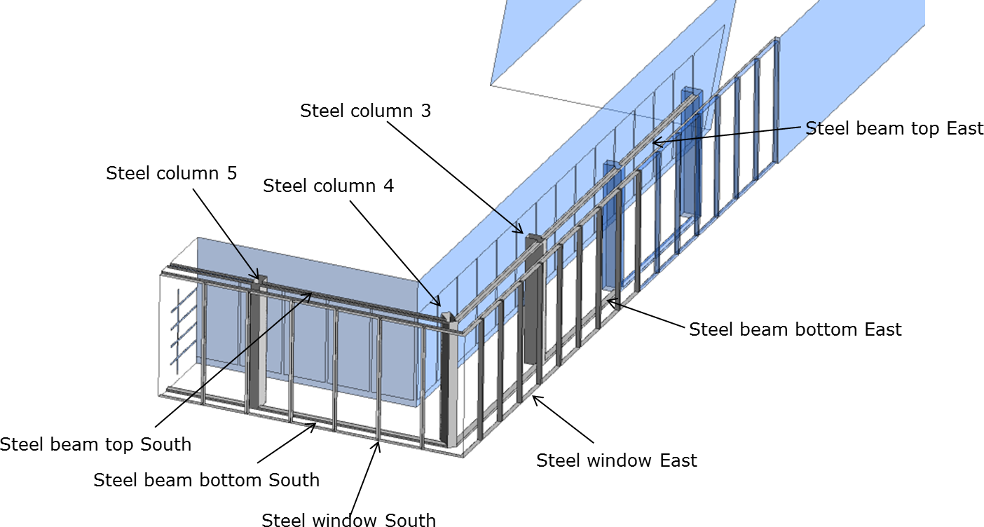
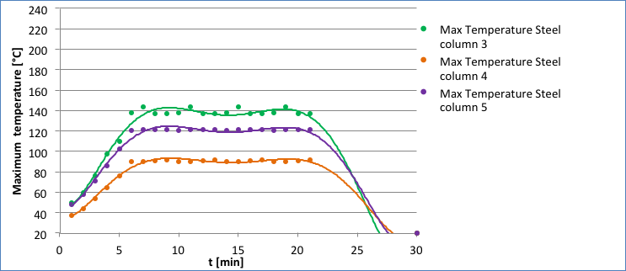
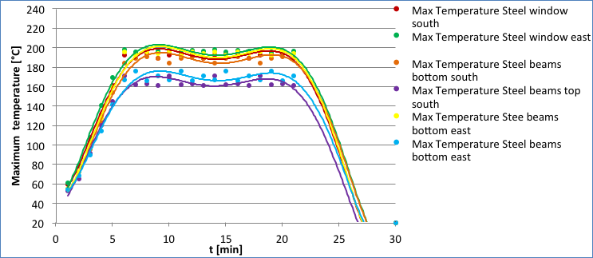
Cases studies: Piedmont Region Headquarters - Turin
Fire Scenario 5 – Fire inside Satellite – no water mist

Slide 40
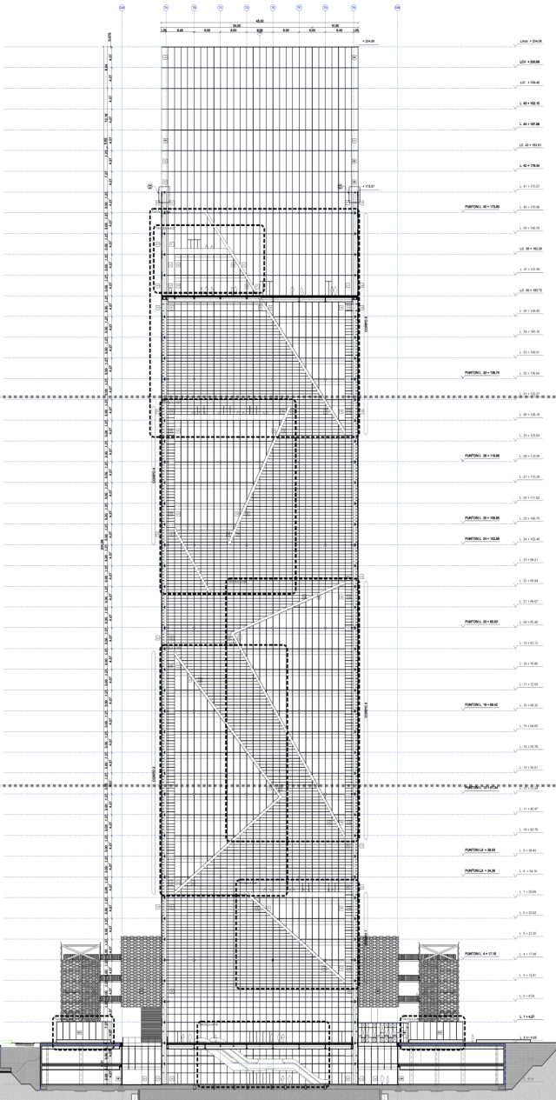

Cases studies: Piedmont Region Headquarters - Turin
Prescriptive solution VS FSE solution
EW 60 i→o
• NO Reaction of fire resistant glass in some weather condition
• NO maintenance of fire resistant glass
• NO maintenance of intumescent painting
• NO stuctural problem for the weight of water curtain
• SAVE SOME MILLIONS OF EUROS
EI 120
after Fire Brigades exception
EI 60
EI 60 bidirezionale

Slide 41
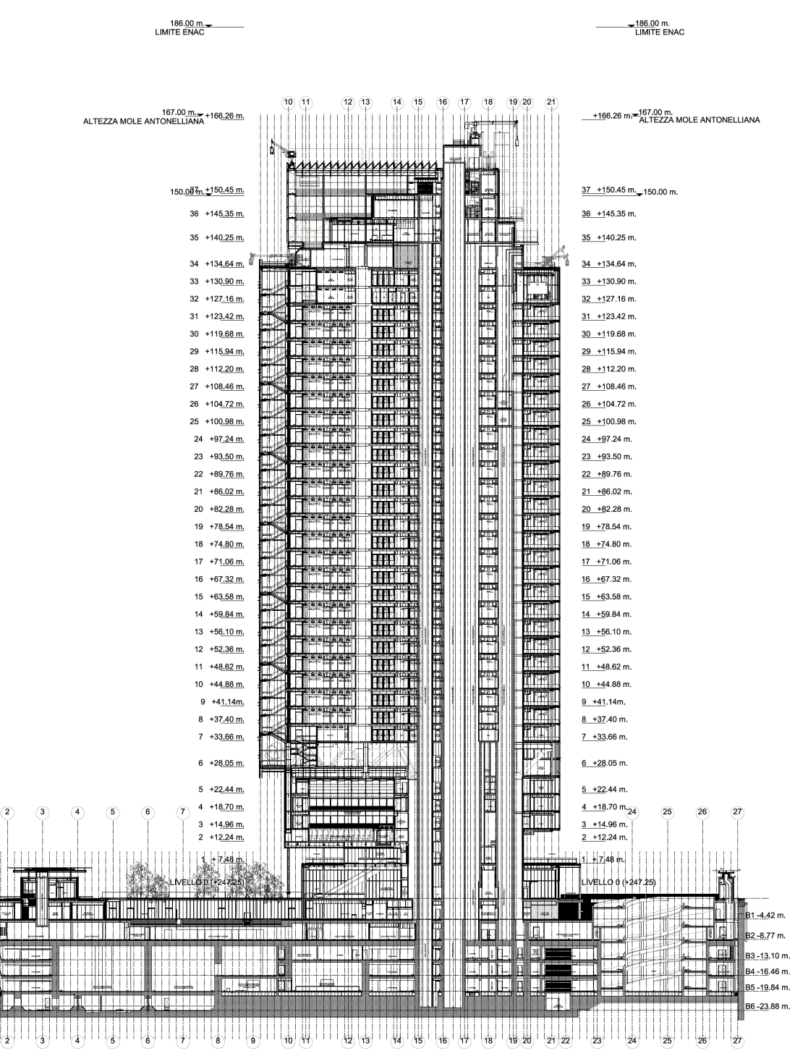
Cases studies: Torre Intesa San Paolo - Turin
"Glasshouse":
Steel-frame structure
Tower’s main body :
- Composite Steel/R.C.
- Steel
- Reinforced Concrete
Transfer nord and sud
Composite Steel/R.C.
Basaments:
Reinforced Concrete

Slide 42
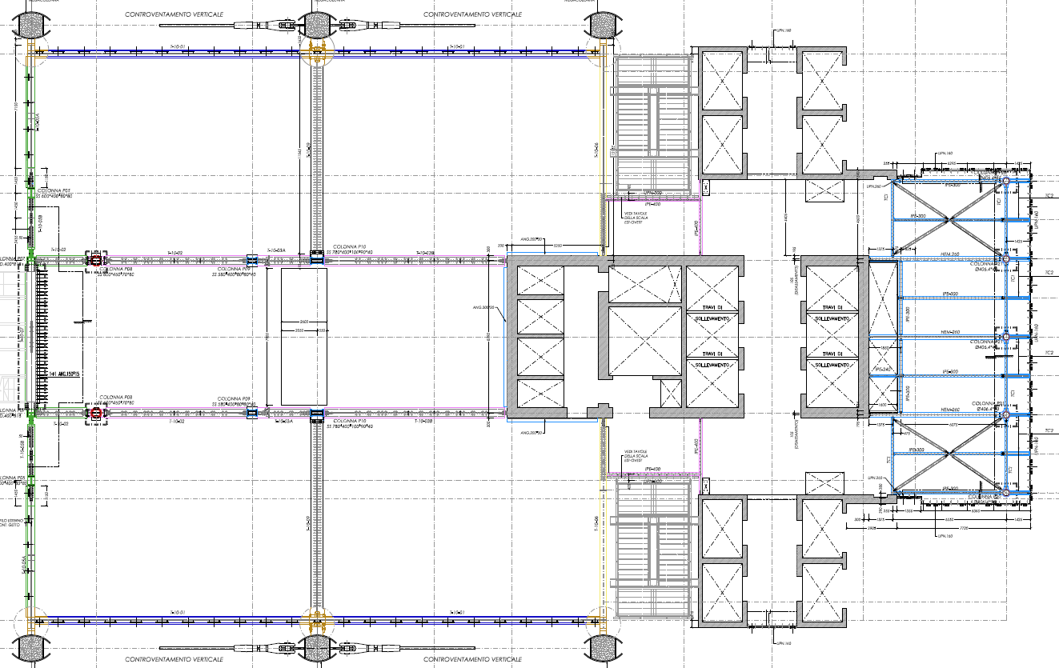
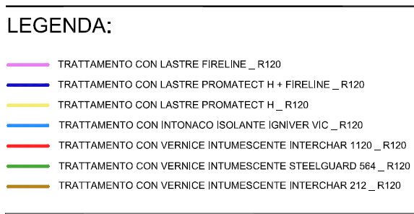
Cases studies: Torre Intesa San Paolo - Turin

Slide 43
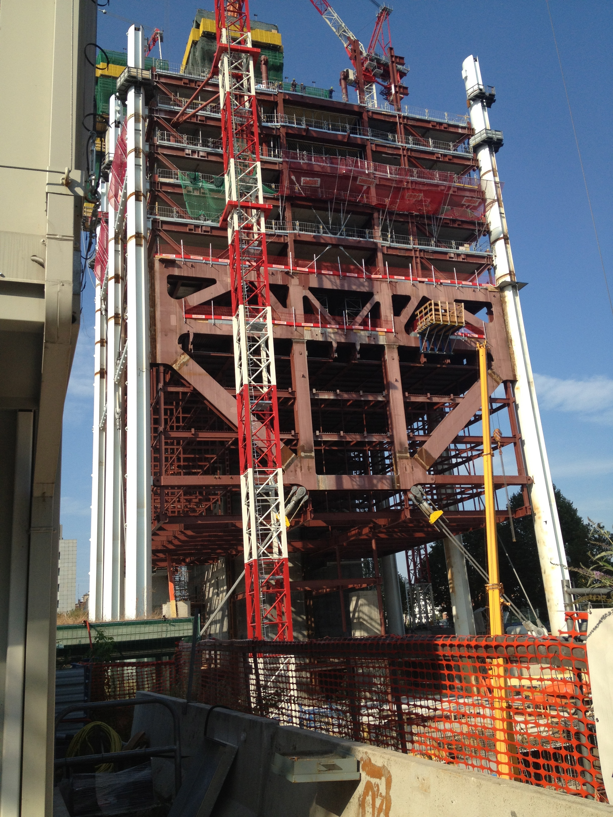
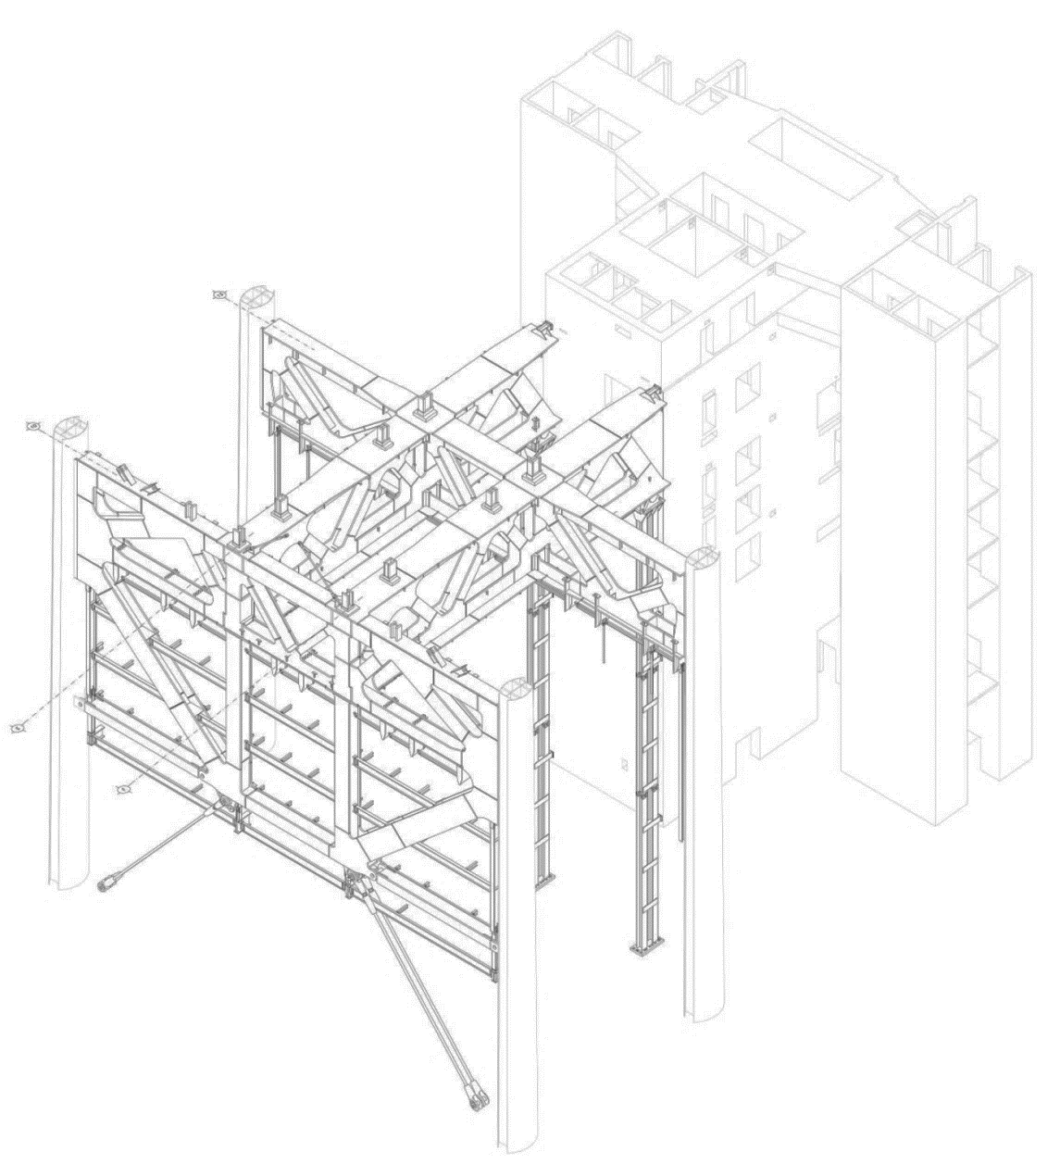
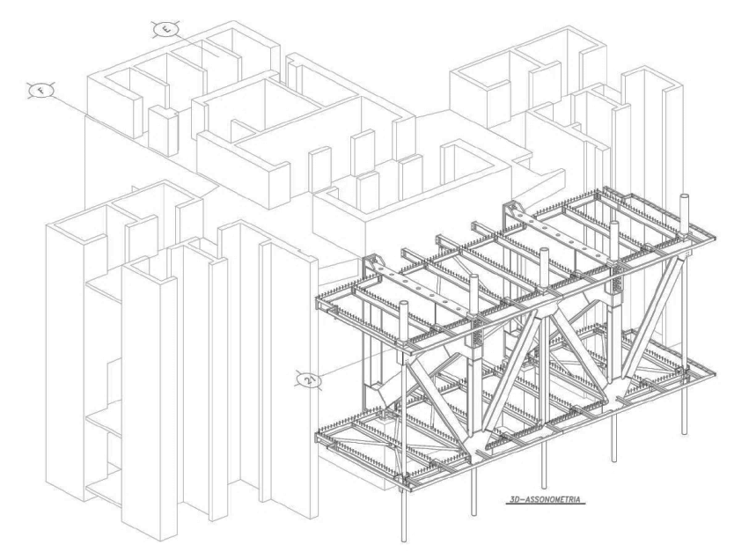
Cases studies: Torre Intesa San Paolo - Turin
"Transfer" structures’ elements, Nord and Sud

Slide 44
Cases studies: Torre Intesa San Paolo - Turin
DESIGN CRITERIA (Targets)
Failure of one megacolumn on 8th and 9th floor on axes 10-13-16;
Absence of truss elements on axis 13;
Concrete core’s resistance contribution lack on torsion;
No resistance contribution by bracings on axis 10;
Failure of a strand in one of East-West façades (axes B and J);
IMMEDIATE USE OF THE TOWER AFTER AN EVENTUAL FIRE (NO GLOBAL DAMEGES ON THE STRUCTURE)

Slide 45
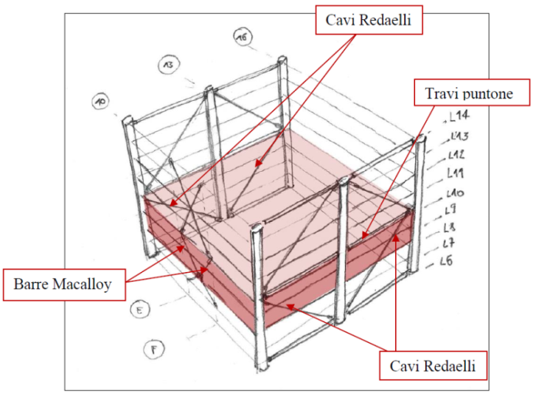
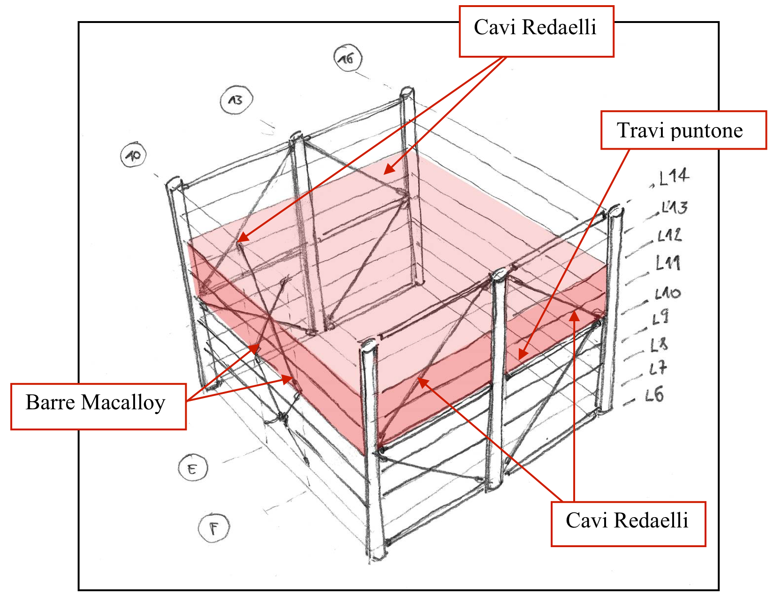
Cases studies: Torre Intesa San Paolo - Turin
FIRE SCENARIOS
1st fire scenario is performed with 2 hours of ISO 834 standard fire exposure along 8 m piece of a Megacolumn (MC), corresponds to a local fire at the tip or base of MC, between L0 and L7;
2nd fire scenario is performed with 2 hours of ISO 834 standard fire exposure for the entire height of MC between L0 and L7 (L=32.5 m);
3rd scenario is performed with ISO 834 standard fire curve in two office levels (from level 8 to the top), which puts at risk the stability of the bracings on B, J and 10 axes (repeated for the entire height of the tower).

Slide 46
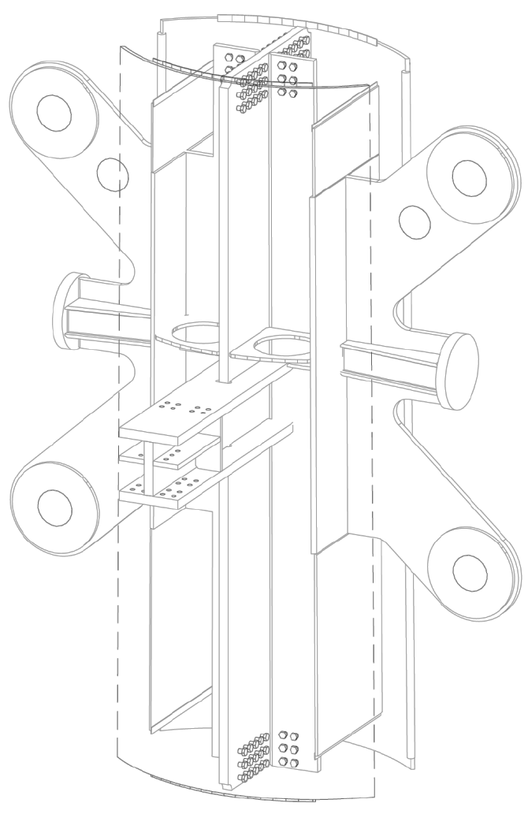


Cases studies: Torre Intesa San Paolo - Turin
MEGACOLUMNS
PROGETTO COSTRUTTIVO:
STRUTTURA MISTA ACCIAIO / C.A.

Slide 47




Cases studies: Te Intesa San Paolo - Turin

Slide 48
Cases studies: Torre Intesa San Paolo - Turin
DESIGN CRITERIA (Targets)
Failure of one megacolumn on 8th and 9th floor on axes 10-13-16;
Absence of truss elements on axis 13;
Concrete core’s resistance contribution lack on torsion;
No resistance contribution by bracings on axis 10;
Failure of a strand in one of East-West façades (axes B and J);
IMMEDIATE USE OF THE TOWER AFTER AN EVENTUAL FIRE (NO GLOBAL DAMEGES ON THE STRUCTURE)

Slide 49
Cases studies: Torre Intesa San Paolo - Turin
LA TORRE:
MECAGOLONNE
1st fire scenario is performed with 2 hours of ISO 834 standard fire exposure along 8 m piece of a Megacolumn (MC), corresponds to a local fire at the tip or base of MC, between L0 and L7;
2nd fire scenario is performed with 2 hours of ISO 834 standard fire exposure for the entire height of MC between L0 and L7 (L=32.5 m);

Slide 50

Cases studies: Torre Intesa San Paolo - Turin
LA TORRE:
Transfer sud
1st fire scenario is performed with 2 hours of ISO 834 standard fire exposure along 8 m piece of a Megacolumn (MC), corresponds to a local fire at the tip or base of MC, between L0 and L7;
2nd fire scenario is performed with 2 hours of ISO 834 standard fire exposure for the entire height of MC between L0 and L7 (L=32.5 m);

Slide 51


Cases studies: Torre Intesa San Paolo - Turin
3rd scenario is performed with ISO 834 standard fire curve in two office levels (from level 8 to the top), which puts at risk the stability of the bracings on B, J and 10 axes (repeated for the entire height of the tower).

Slide 52


PALAZZO ITALIA

Slide 53




PALAZZO ITALIA

Slide 54



PALAZZO ITALIA – Scenario 1

Slide 55


PALAZZO ITALIA – Scenario 2

Slide 56


PALAZZO ITALIA – Scenario 3

Slide 57



PALAZZO ITALIA – Risultati scenario 1

Slide 58




PALAZZO ITALIA – Risultati scenario 2

Slide 59



PALAZZO ITALIA – Risultati scenario 3

Slide 60
MALL OF QATAR - DOHA

Slide 61

MALL OF QATAR - DOHA

Slide 62

INCENDIO REALE IN COPERTURA
MALL OF QATAR - DOHA

Slide 63


INCENDIO REALE IN COPERTURA
MALL OF QATAR - DOHA

Slide 64

INCENDIO REALE IN COPERTURA
MALL OF QATAR - DOHA

Slide 65
INCENDIO REALE IN COPERTURA
MALL OF QATAR - DOHA

Slide 66

INCENDIO REALE IN COPERTURA
MALL OF QATAR - DOHA

Slide 67

INCENDIO REALE IN COPERTURA
MALL OF QATAR - DOHA

